Slide 1
Nature & Design
ART 1600, Aesthetics of Architecture, Interiors & Design

Slide 2
Concepts In Design:
Nature
There are three complex words here:
concepts
design
nature
What do each of these mean?

Slide 3
Concepts in Design
A concept is a statement, usually written, that expresses what it is that the designer is aiming for, in an overall sense, in a project.
A 'holiday' is a concept.
A 'seaside holiday' is more specific.
There can be yet more detail: a beach holiday, a yachting holiday, a bird-watching holiday, an adventure holiday, etc.
The value of concepts is that we can use them to 'breed' ideas.
Concepts can be categories of functions or an assembly of things or activities.
An 'activity' is a concept. A 'game' is a more specific concept. 'Football' is yet more specific. The match between two specified teams is the actuality.

Slide 4
Concepts in design may be very broad, or very specific
An architectural concept for a project could be:
Transparency
Horizontal & Vertical Forms and their visual effects
Integration With Nature
Pathways; designing spaces as sequential experiences
Inside & Outside Relationship

Slide 5
A Design Philosophy
A philosophy is a bigger, grander, statement of a designer’s professional world view.
Design philosophies are fundamental guiding principles that dictate how a designer approaches his/her practice.

Slide 6
Contemporary Approaches to Design
Reflecting a Design Philosophy
Site Specific Contextual Design/Critical Regionalism
Bio Mimicry
Parametric Design
Environmental Design
Social and Behavioral Design

Slide 7
Design
design as a verb:
  decide upon the look and functioning of (a building, a chair, or other object), typically by making detailed drawings and other studies of it.
design as a noun:
  a plan or drawing produced to show the look and function or workings of a building, chair, or other object before it is built or made.

Slide 8
Designing
(as activities, as a verb) is what most architects and interior designers ‘do’
Designing includes:
  ideation (coming up with ideas)
  sketching
  diagramming
  model making
  researching
  interviewing
  prototyping
  understanding user/client needs

Slide 9
Nature
What is ‘nature’ and how do we define it?
  Nature, in the broadest sense, is equivalent to the natural, physical, or material world or universe.
  "Nature" refers to the phenomena of the physical world, and also to life in general. It ranges in scale from the subatomic to the cosmic.
  The word nature is derived from the Latin word natura, or "essential qualities, innate disposition", and in ancient times, literally meant "birth".

Slide 10
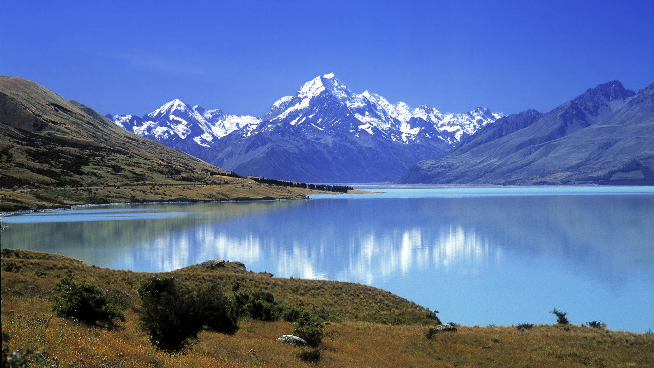
A ‘natural’ scene no human role in this environment

Slide 11
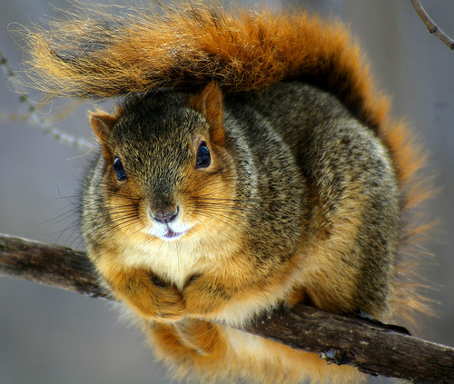
A ‘natural’ scene

Slide 12
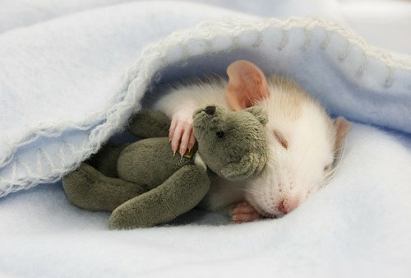
A domesticated scene sleeping rat with stuffed toy

Slide 13
Are humans (you, me) ‘natural’?
We like to separate humans and the things they make from the rest of the universe.
We say the ‘natural and the man made’ make up the whole universe.
Being ego centric creatures, and believing that we are superior to all other creatures, we find this simple bifurcation of the world to be appealing.
Regardless of the validity or legitimacy of it, this distinction does help us organize the world around us.

Slide 14
Nature & Design
Form, Function, Material, Systems
Using biological form and functionality as the basis for man made works of design is referred to as ‘biomimicry.’
The natural world is one of inter-related systems; eco systems, support systems, survival systems.
There is a popular move in current design to look at the natural world and to try to mimic the ways it works in the human built world.
Forms in nature are sometimes geometric, and sometimes not.

Slide 15
Homework: Watch this video outside of class
Exam 6 will contain questions about this video!
Using Nature's Genius In Architecture (a 16 minute TED Talk)

Slide 16
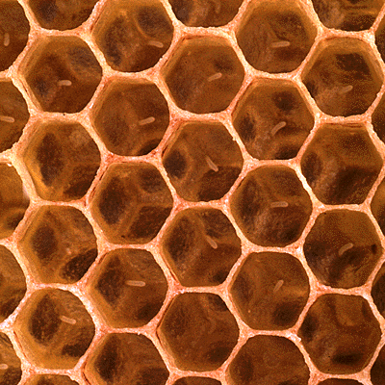
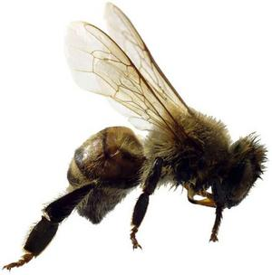
The Product & The Designer/Fabricator a precise geometry a set of functions, a social component

Slide 17
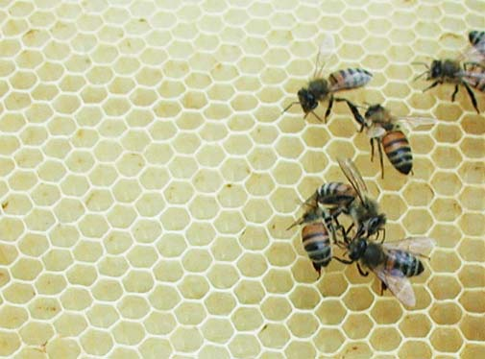
The Product & The Designer/Fabricator

Slide 18
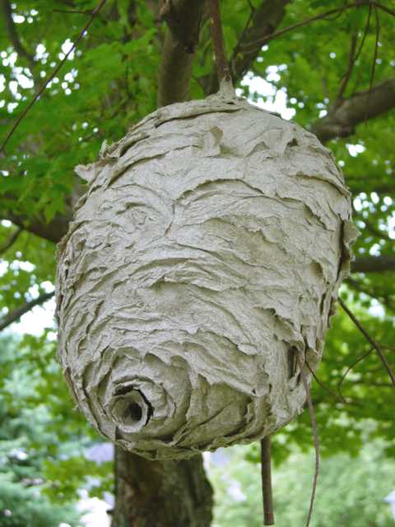
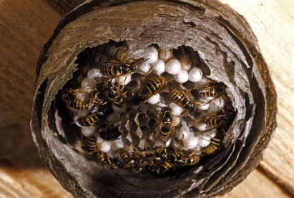
A wasp’s nest: not a simple or obvious geometry

Slide 19
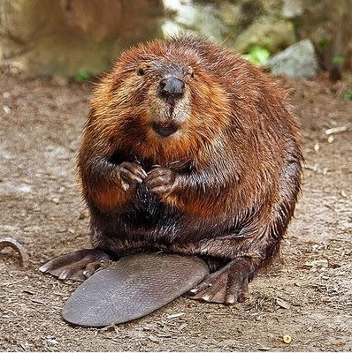
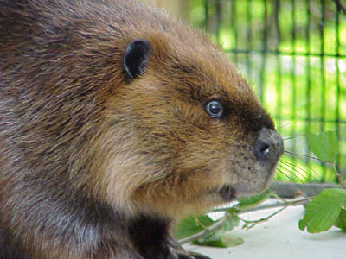
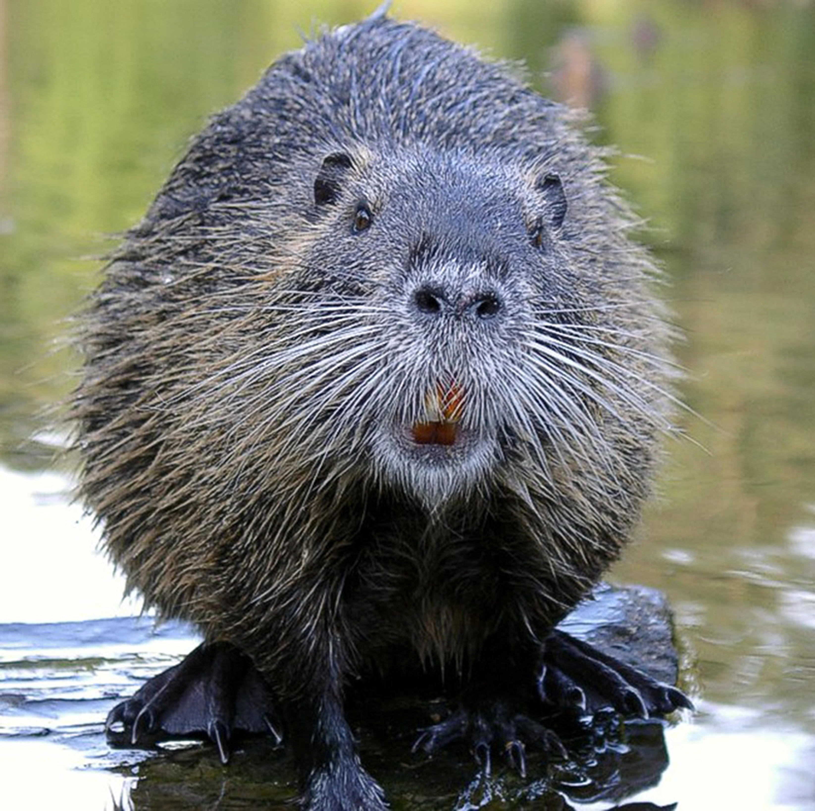
A Fabricator & Designer

Slide 20
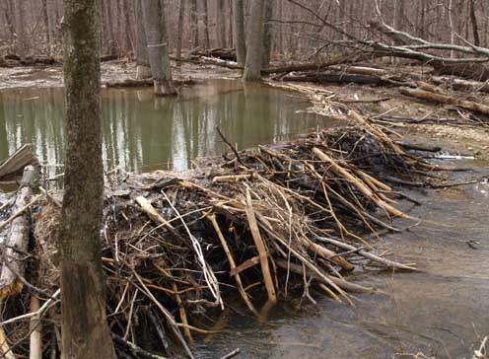
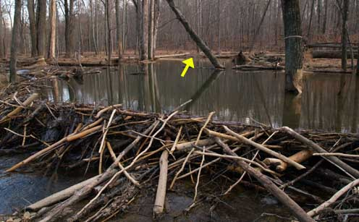
A water barrier and a residence constructed by beavers
National Geographic: Beavers Building a Dam (a 2minute video)

Slide 21
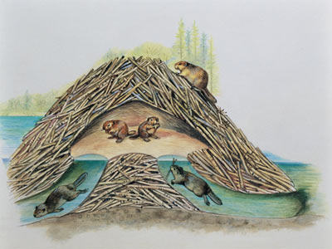
Section through a beaver’s dam http://animals.howstuffworks.com/mammals/beaver-dam.htm

Slide 22
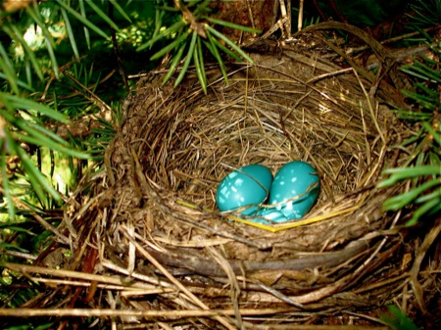
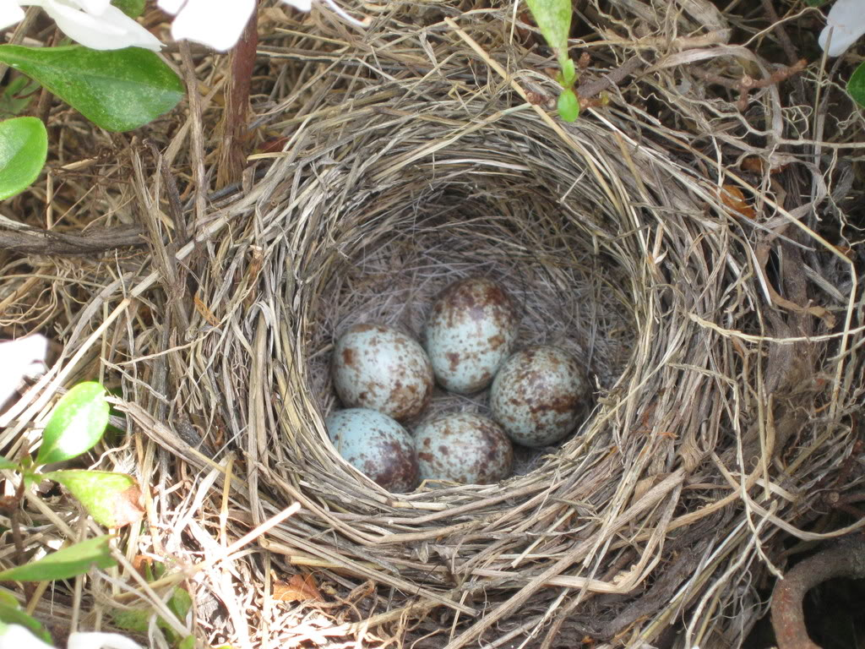
Bird nests: organized purposeful and functional construction by ‘natural’ creatures

Slide 23
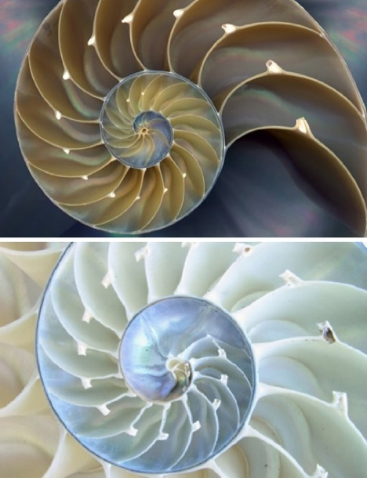
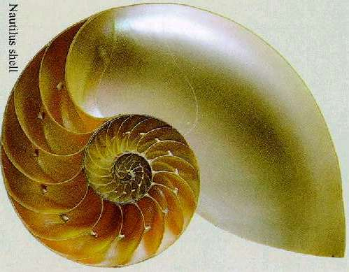
The chambered Nautilus shell: a highly ordered physical object
(it is close to a physical depiction of the Fibonacci series)

Slide 24
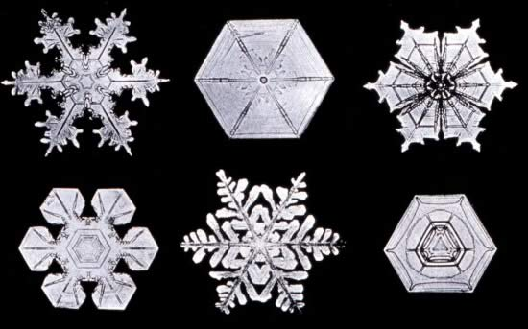
Wilson Bentley, a Vermont farmer, took photographs of snowflakes under a microscope as a hobby.
These photographs were published in the
“Monthly Weather Review” in 1902.

Slide 25
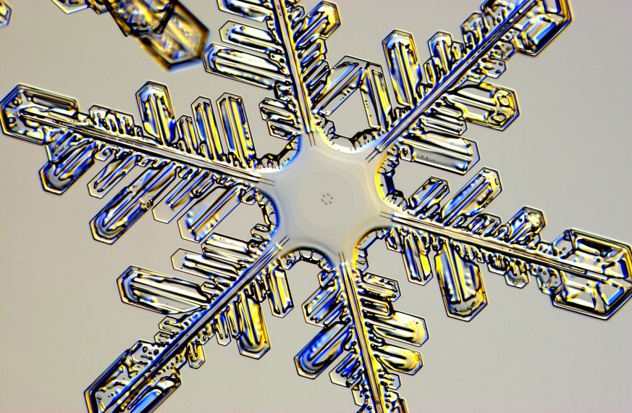
A single snowflake
Scientists today believe that all snowflakes fall into one of 35 shapes.

Slide 26
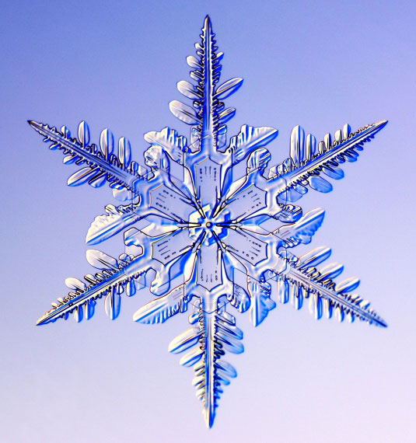
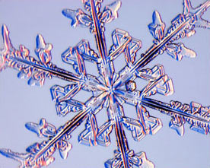
Snowflakes:
Beautiful and complex form

Slide 27
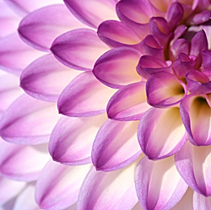
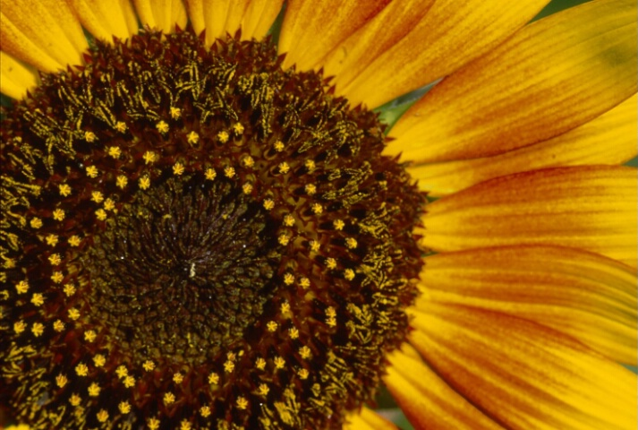
Flowers exhibit pattern not to mention color and form

Slide 28
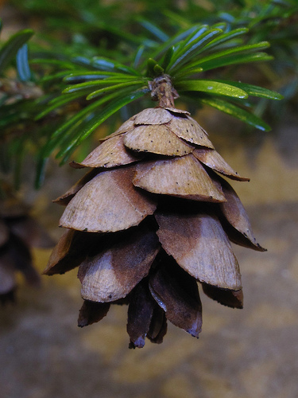
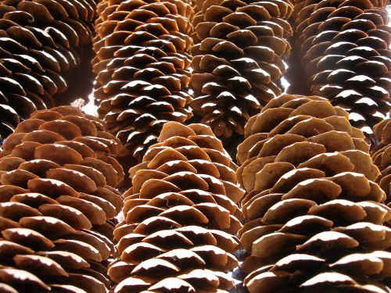
Geometry, pattern, material, form

Slide 29
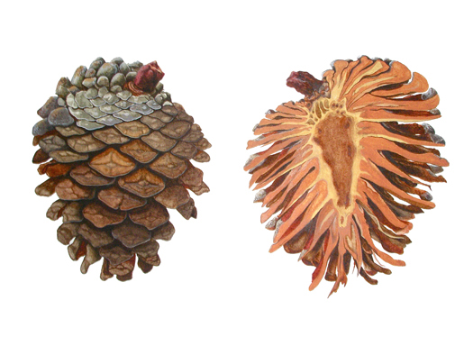
Elevation & Vertical Section of a pine cone

Slide 30
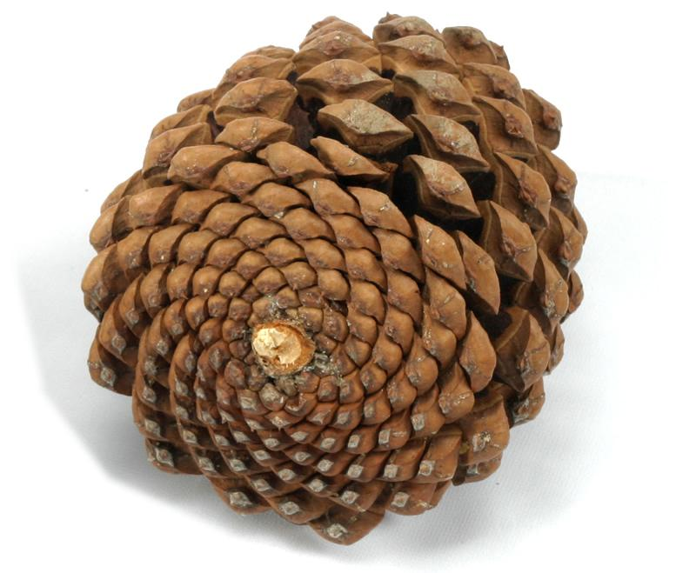
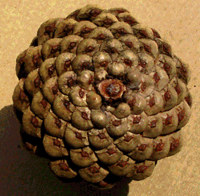
Spiral pattern of a pine cone

Slide 31
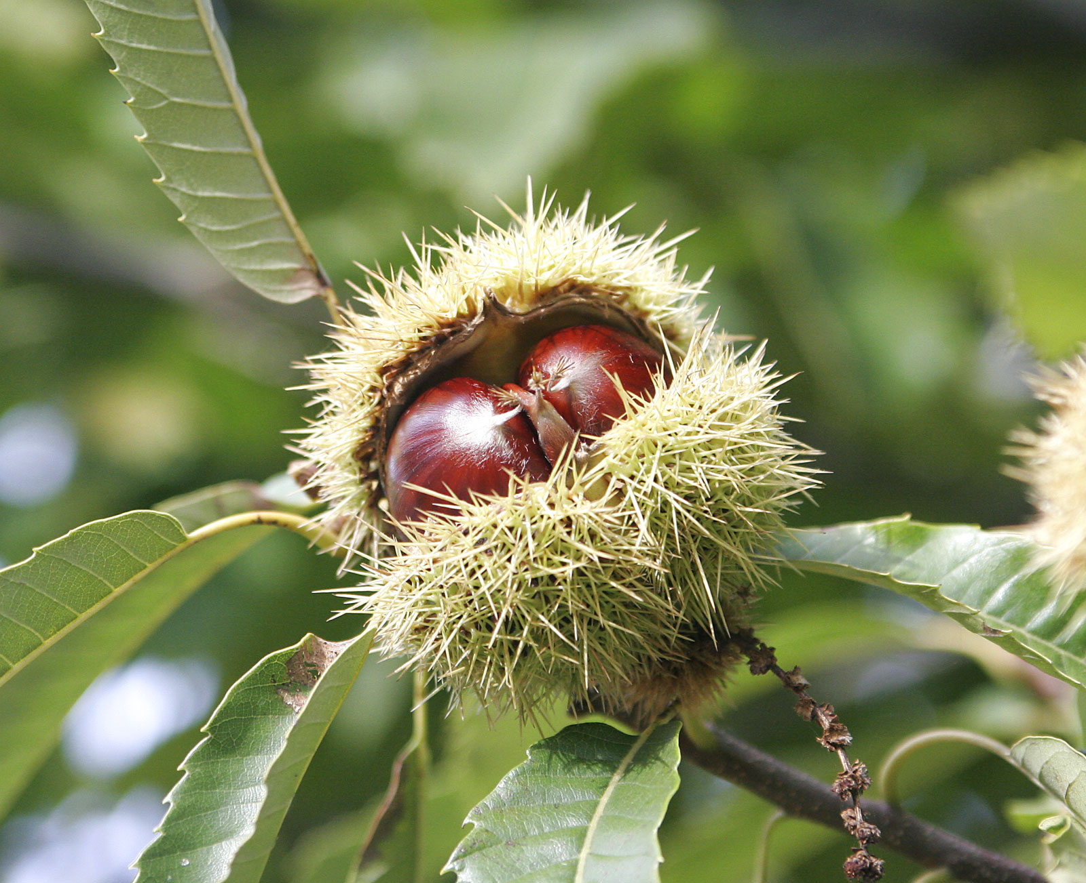
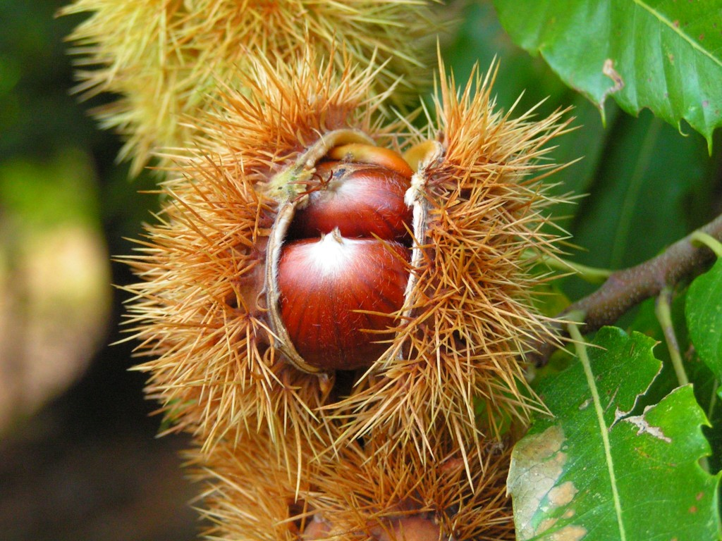
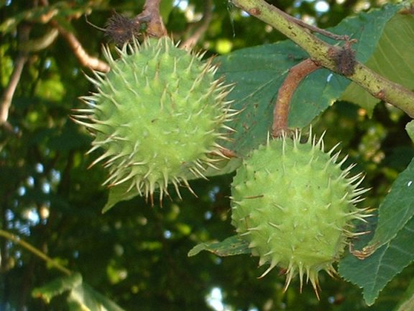
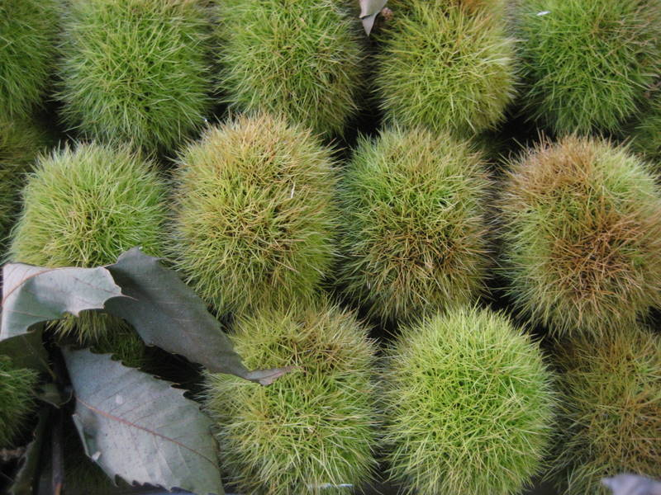
A chestnut exists within a system of components and processes that tie together the cosmic and the molecular; sunlight, atmosphere of water and gases, nutrients, and a relationship to other creatures and plants all of whom are partly or fully dependent upon one another for survival.

Slide 32
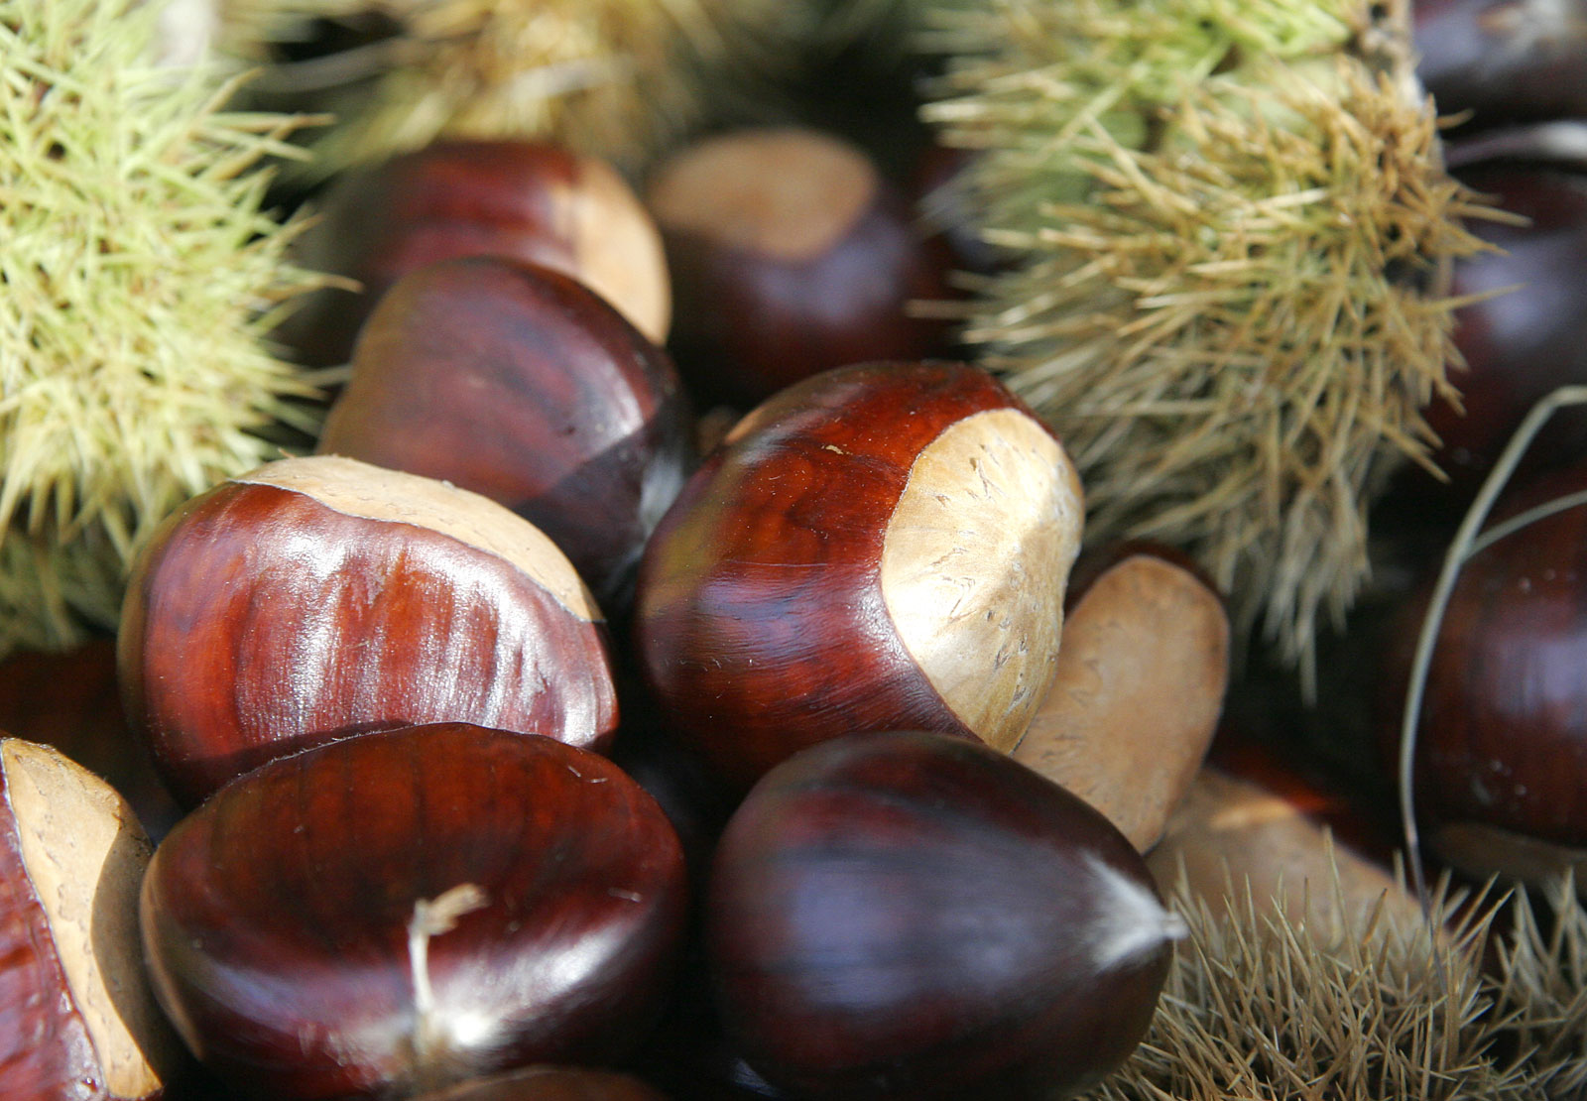
Chestnuts exemplify a natural complexity of form, material, color, function

Slide 33
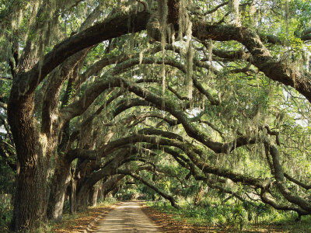
Live Oak trees in Georgia

Slide 34
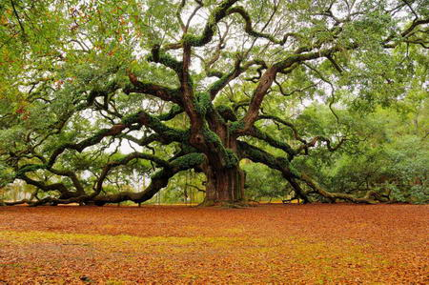
An Angel Oak tree in South Carolina

Slide 35
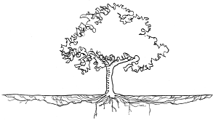
Most roots are relatively shallow (three feet or less deep) with most roots within 12 inches of the surface. Roots extend well past the canopy drip line. Taken from University of Minnesota Sustainable Urban Landscape Information Series

Slide 36
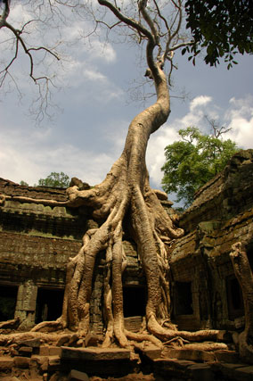
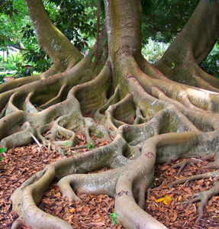
Roots are like building foundations: they support the physical parts above them and anchor the tree to the ground. Roots draw in water and nutrients.
A temple in Angkor, Cambodia (left)

Slide 37
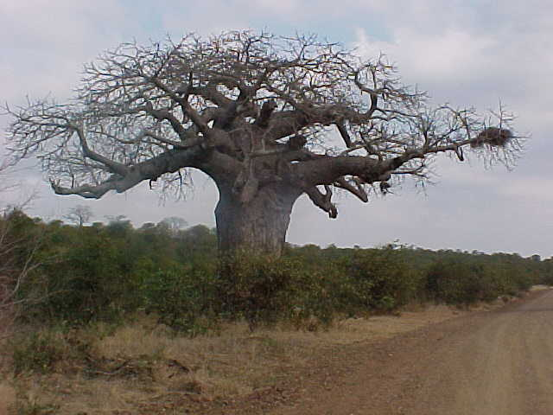
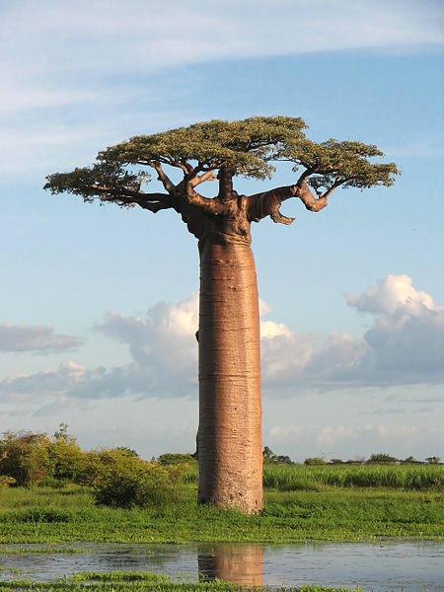
African Baobab tree one has been carbon dated to be 1275 years old
The trunks store large
amounts of water

Slide 38
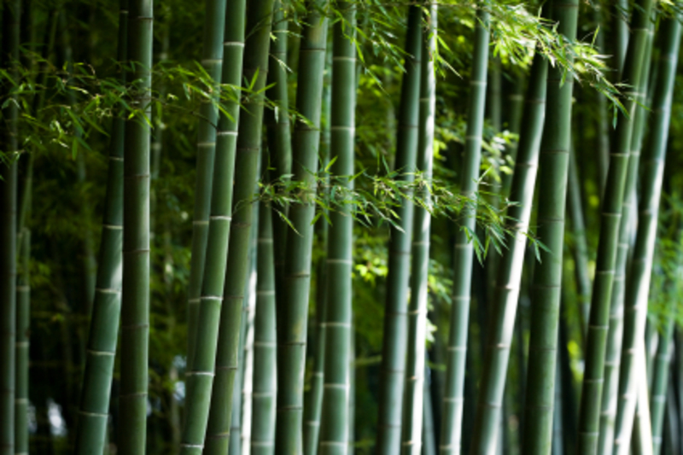
Bamboo:
A fast growing, replenishable, sustainable source of wood.

Slide 39
Bamboo as an ‘eco’ material?
Fast-growing and robust, bamboo is a popular alternative to hardwood.
The carbon sequestering grass has a lot going for it, but buyer beware: that bamboo floor doesn’t seem so green if it was planted at the expense of native forests, grown with pesticides, and sealed with formaldehyde.
not to mention being transported by truck to a cargo ship, across an ocean onto another truck, driven across the country and finally to a home improvement store in your town.
When it is grown locally and processed locally it will truly be an
‘eco’ material.

Slide 40
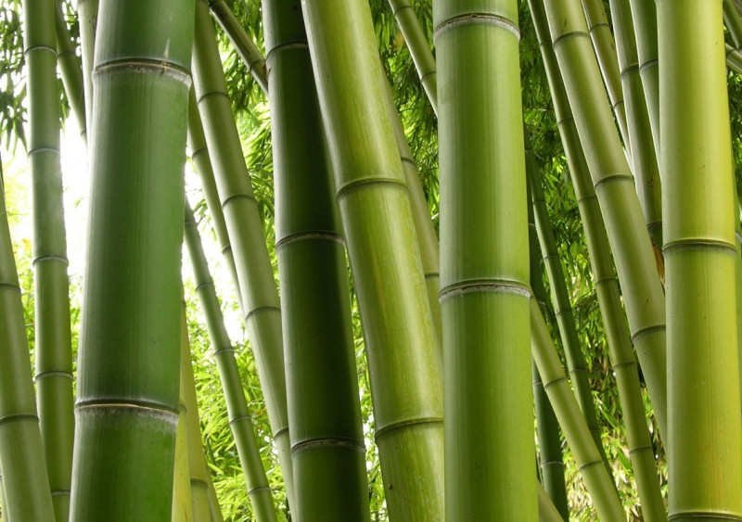
Bamboos are some of the fastest growing plants in the world with reports of 100 cm (39 in) in 24 hours

Slide 41
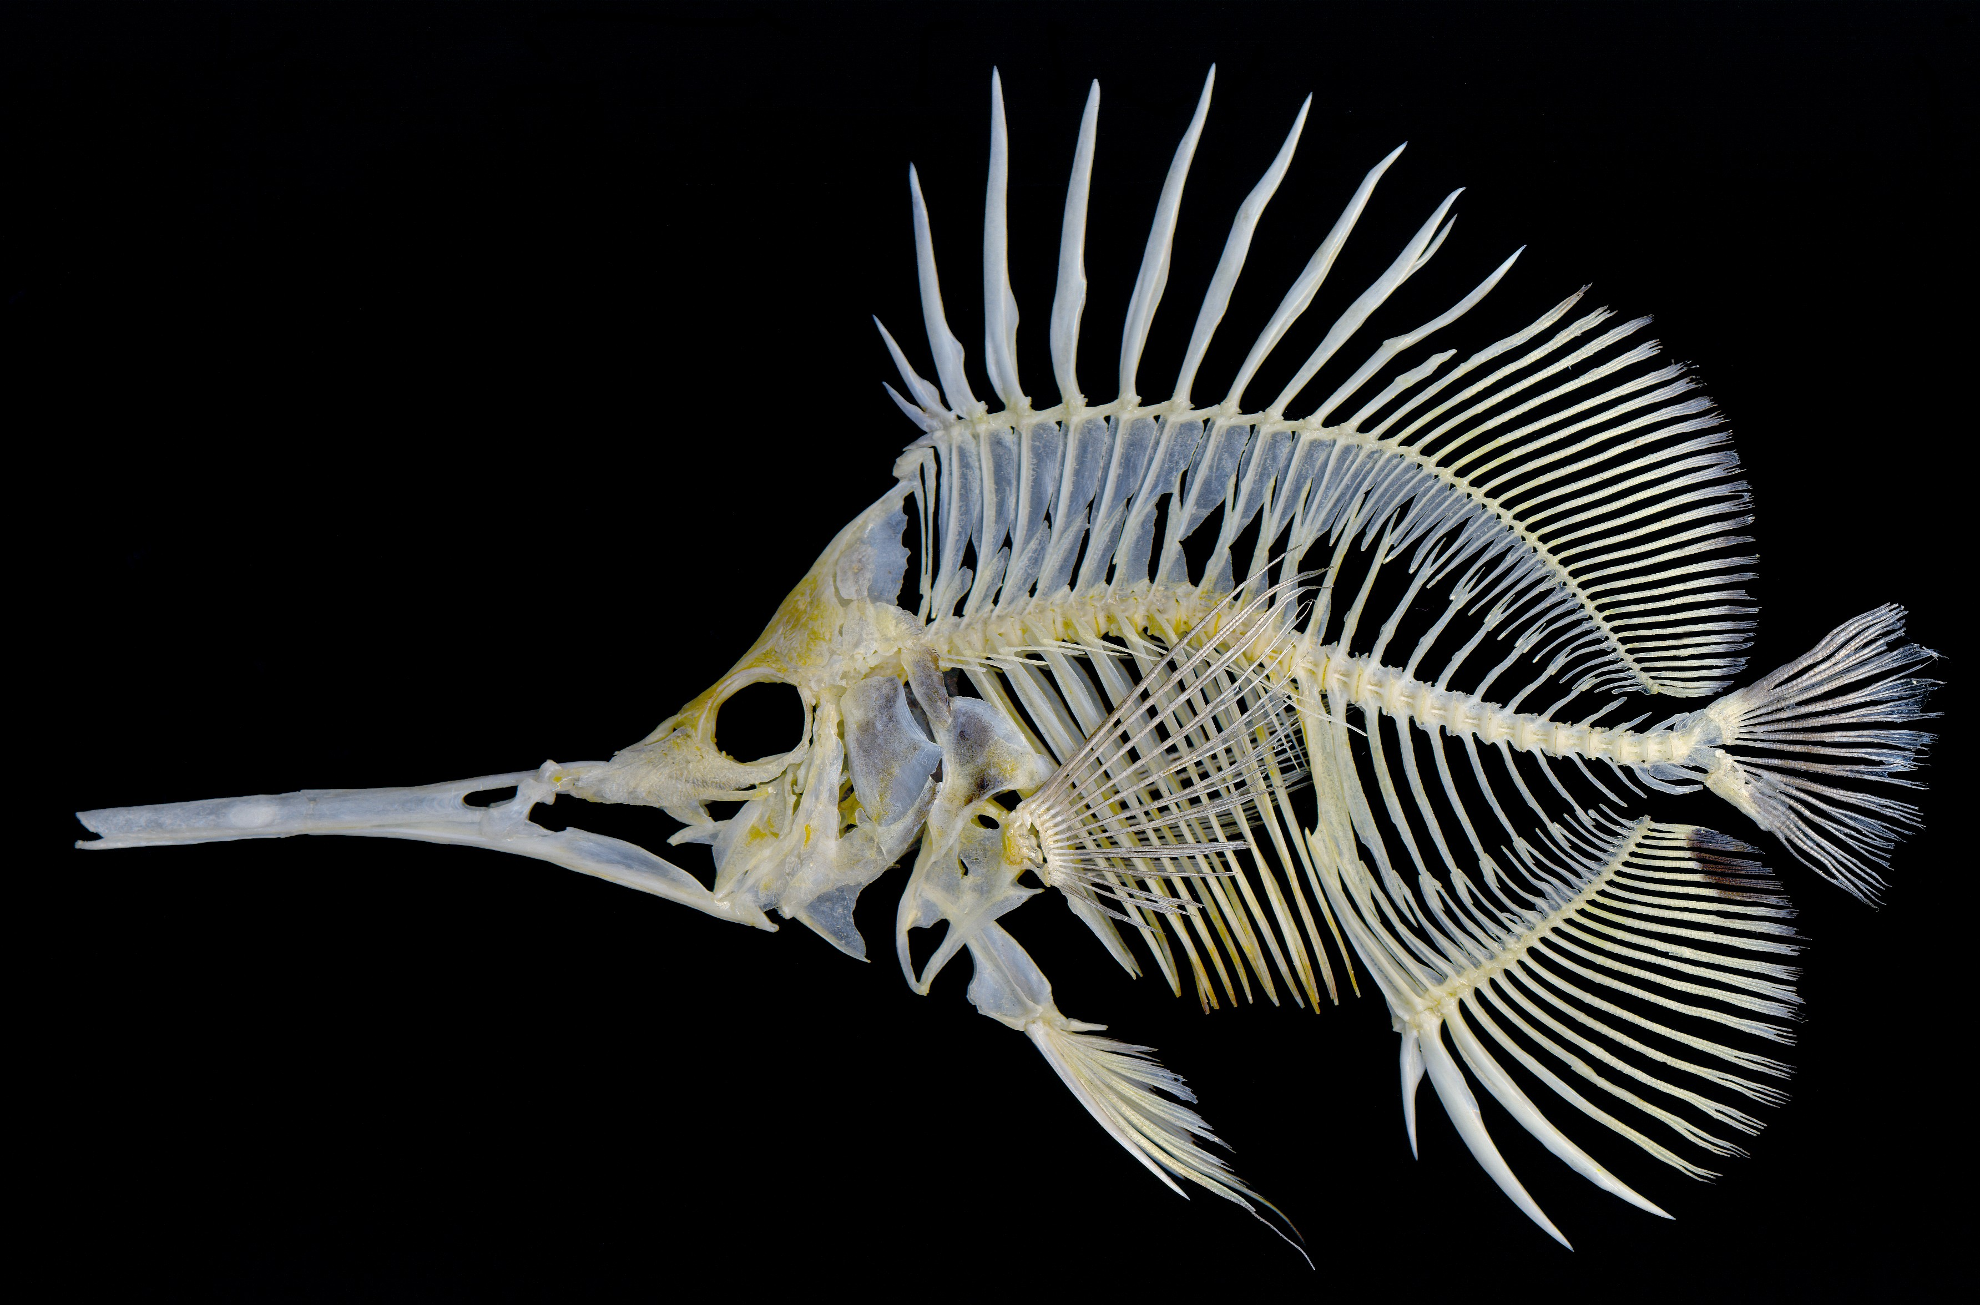
Structure, order, form, hierarchy, line, plane, volume.

Slide 42
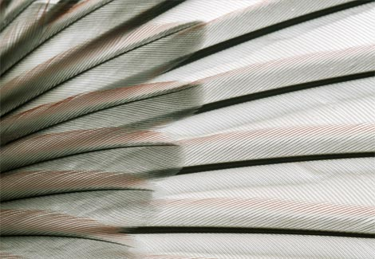
Sparrow feathers
Structure, order, form, hierarchy, line, plane, volume.

Slide 43
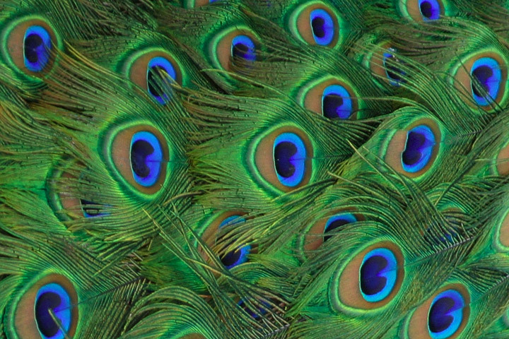
Peacock feathers
Structure, order, form, hierarchy, line, plane, volume.

Slide 44
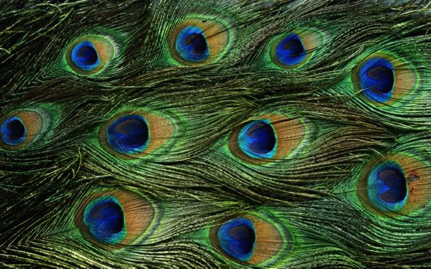
Structure, order, form, hierarchy, line, plane, volume, color, pattern and texture.

Slide 45
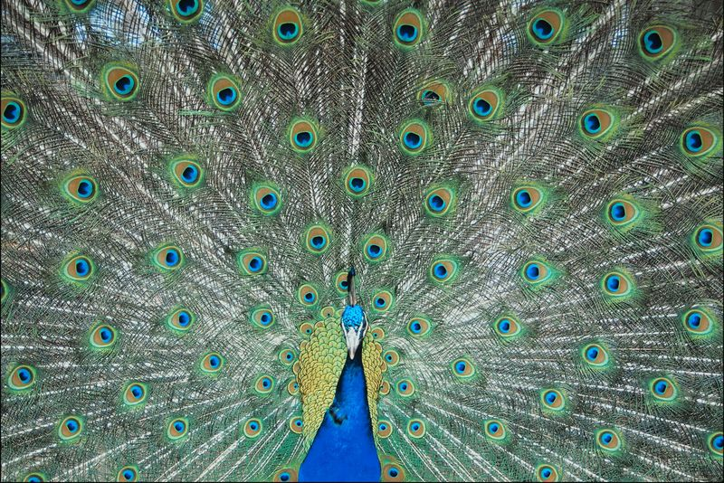
The Peacock with his feathers

Slide 46
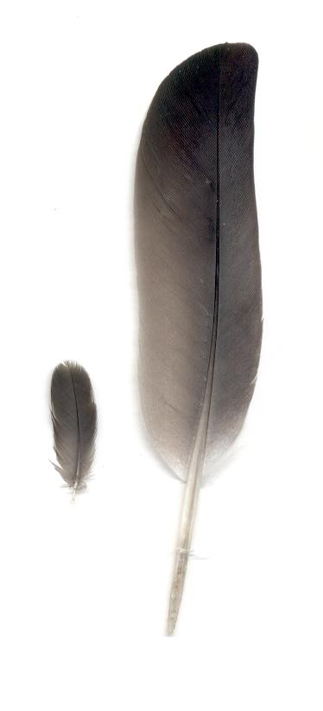
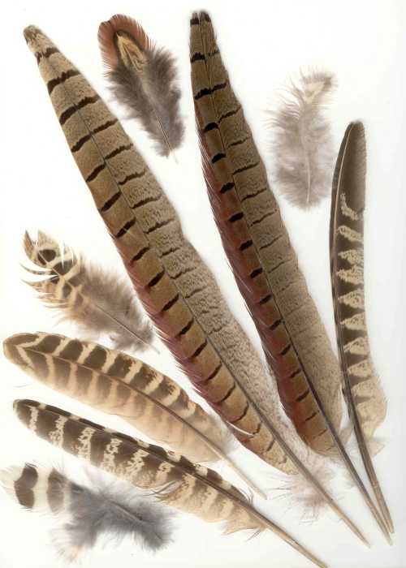
Natural elements often contain many, perhaps all, of the qualities that human beings strive to bring together in manmade, designed, products.

Slide 47


A Great Horned Owl

Slide 48


A masked weaver and a Spoonbill

Slide 49

Penguins

Slide 50

Toucan, of Central and South America

Slide 51

Oystercatcher

Slide 52


A blue jay and a rock bird

Slide 53

A dandelion seed ‘puff’

Slide 54


Part of the ‘system’ of the dandelion plant shown in a holistic image

Slide 55

Bio Mimicry
A human attempt to mimic nature

Slide 56
Bio Mimicry
Biomimicry or biomimetics is the examination of nature, its models, systems, processes, and elements to emulate or take inspiration from in order to solve human problems.
The term biomimicry and biomimetics come from the Greek words bios, meaning life, and mimesis, meaning to imitate. Similar terms include bionics.
(From Wikipedia)

Slide 57

The philosophy of biomimicry assumes Nature as a constant of reference to a performance-based beauty for design.

Slide 58

Imitating nature has become a meaningful approach for contemporary architects and design futurists to the built environment, especially for those who foster a future that doesn’t compete with nature but coexist with it.
The study of bone form and growth has led to structural design innovations in buildings and in furniture.

Slide 59

Building structural system designed using a model of bone strength and shape

Slide 60

Building structure interpreted through bio mimicry

Slide 61

On a somewhat less serious note, the ‘Biomimicry Shoe’ designed by Marieka Ratsma and Kostika Spaho

Slide 62

the ‘Biomimicry Shoe’ designed by Marieka Ratsma and Kostika Spaho

Slide 63

A wood pecker and a small folding saw
“You talking to me?”

Slide 64


‘Vegetal Chair’ by Ronan and Erwan Bouroulled
Mercedes Benz Bionic Car Skeleton

Slide 65


Bio mimicry: making use of natural systems and processes in man made elements.

Slide 66



Joris Laarman chairs inspiration from the way bones grow

Slide 67



Joris Laarman tables

Slide 68

Once again humans copy Nature

Slide 69



The Leaf House, by Undercurrent Architects
Australia

Slide 70


The Leaf House, by Undercurrent Architects
Australia

Slide 71


Beijing olympic swimming facility: mimicking cell structure

Slide 72

One Ocean, the stunning solar-powered, naturally ventilated Thematic Pavilion designed by Vienna-based Soma Architecture in Yeosu, South Korea.

Slide 73
One Ocean, the stunning solar-powered, naturally ventilated Thematic Pavilion designed by Vienna-based Soma Architecture in Yeosu, South Korea.
Designed to keep visitors cool during humid summers, One Ocean is also a nod to biomimicry with its gill-like façade that overlooks the harbor.
The soaring glass fiber gills are designed to function like lamellas, the papery ribs under a mushroom’s cap.

Slide 74

‘The Bird’s Nest’ Stadium, Bejing, China built for the 2008 Olympics designed by architects Herzog & De Meuron

Slide 75

The building is known as the ‘bird’s nest’

Slide 76
Structure of ‘The Bird’s Nest’ Olympic Stadium
In an effort to design a stadium that was "porous" while also being "a collective building, a public vessel”, the team studied Chinese ceramics.
This line of thought brought the team to the "nest scheme”.
The stadium consists of two independent structures, standing 50 feet apart: a red concrete seating bowl and the outer steel frame around it.

Slide 77

Structure of ‘The Bird’s Nest’ Olympic Stadium

Slide 78



Slide 79



Zaha Hadid, architect & designer
Ideal House
Cologne,Germany natural and biological forms such as bones, cells, and flowing water

Slide 80


Zaha Hadid, architect & designer
Avilon Triflow water faucet
Inspired by the fluid movement of water. The design by Zaha Hadid Architects creates a form derived from the internal movements of water, as a single fluid gesture, where all parts are meant to convey the continuous flow between tap, work surface, and basin.

Slide 81


Zaha Hadid, architect & designer
Hauser and Wirth Table

Slide 82

Zaha Hadid web page http://zahahadid.vm.bytemark.co.uk/
The process of creating Zaha Hadid’s unique exhibition design was similar to carving a sculpture from solid blocks of material.
The table and shelf were made through a combination of hi-tech and traditional craftsmanship. The newest automotive manufacturing techniques are used to whittle solid blocks of aluminium into the basic shapes of leg and tops.
Each piece is then hand polished, welded and polished again by expert craftsmen in the Midlands to create a singular seamless piece.
Table and shelf become an organisation of three separate pieces suited to the gallery and its walls, which are constructed of fabric stretched over a framework, like a canvas.
The display can be rearranged after the exhibition into an array of combinations.

Slide 83

Ayodhyatra’s Moss Table made using dried moss

Slide 84


Designer Jukka Lommi created the stylish Koura Chair wooden seating for the Punkalive furniture manufacturer based in Punkaharju, Finland. The chair features a seamless wood shaped into a beautiful geometry, manufactured from Kerto, a laminated veneer lumber product manufactured by Finnforest.

Slide 85


Bone Furniture by Joris Laarman
Aluminium chair is the first in a series of works which are designed according to the way bones develop; growing where strength is needed, and shrinking where it is not.

Slide 86

Bookshelf by dbd Studio.
Contemporary digitally fabricated bookshelf designed with organic curving surface and made of 17 sheets of 3/4″ birch plywood created by dbd Studio for a condo in Washington, DC

Slide 87

Natural tree branch form used for table leg

Slide 88

Jean Nouvel’s National Museum in Doha, Qatar
Qatar National Museum by Jean Nouvel (a 6 minute video)

Slide 89

The museum’s innovative design created by eminent architect Jean Nouvel is inspired by the desert sand rose. This 21st century institution will celebrate the culture, heritage and future of Qatar and its people.

Slide 90
Qatar National Museum designed by Jean Nouvel
The starting point of the design was the desert rose, tiny formations that crystallize below the desert's surface.
Made primarily from steel and concrete which will be locally sourced / fabricated, the new building will be constructed from dozens of interlocking disk-like forms varying in curvature and diameter, suggestive of the blade-like petals of the desert rose. they will intersect at various angles, some standing, others acting as support elements or lying horizontal, creating an uneven pile.
They will be made from steel truss structures, and will be assembled in a hub-and-spoke arrangement, all clad with glass fiber reinforced concrete panels. columns concealed within the vertical disks, carry the loads of the horizontal disks to the ground. his design is a manifestation of the Qatari identity, through a building appearing as if it is growing out of the ground.

Slide 91

Jean Nouvel’s National Museum in Doha, Qatar

Slide 92
Jean Nouvel’s National Museum in Doha, Qatar
The aesthetic of layered plates on the exterior will be mirrored on the museum's interior.
Floors will be done in a sand-colored, polished concrete, and the vertical disk walls will be clad in a 'stuc-pierre', a traditional gypsum and lime-blended plaster formulated to imitate stone.

Slide 93

Jean Nouvel’s National Museum in Doha, Qatar

Slide 94

Jean Nouvel’s National Museum in Doha, Qatar

Slide 95

A gypsum rock called a ‘desert rose.
Jean Nouvel used this natural form as the direct ‘inspiration’ for his National Museum in Qatar.

Slide 96

A gypsum rock called a ‘desert rose.

Slide 97

Jean Nouvel’s National Museum in Doha, Qatar

Slide 98

A naturally constructed (grown!) mobile home environment

Slide 99

A structural shell

Slide 100

So, what do turtles and architecture have in common?
Well, really, quite a lot! Arches, buttresses, geodesic domes, keystones.

Slide 101


Gothic vaulting & turtle shell structure

Slide 102

Beijing International Airport
‘The Turtle Shell’

Slide 103

‘Peoples Gas Education Pavilion’
Chicago, Lincoln Park designed by Studio Gang Architects

Slide 104

There's a dialogue of textures between the gnarled expanse of tortoise-shell fiberglass inserts and the elegant near-gothic-tracery of the wood structure.

Slide 105

‘Peoples Gas Education Pavilion’
Chicago, Lincoln Park designed by Studio Gang Architects

Slide 106

‘Peoples Gas Education Pavilion’
Chicago, Lincoln Park designed by Studio Gang Architects

Slide 107

‘Peoples Gas Education Pavilion’
Chicago, Lincoln Park designed by Studio Gang Architects

Slide 108
‘Peoples Gas Education Pavilion’
Chicago, Lincoln Park designed by Studio Gang Architects
The wood pieces, of Douglas Fir, "one of the strongest structural grade species" are bent in forms, "similar to the way you would make bent wood furniture.
Layers of lamination are wetted and glued together.
It's better for the environment because you're not cutting up large trees.
More waste pieces can be used.
We also had to have ASTM structural testing done because it's the first time this type of laminated veneer lumber is being used in a such a structure."

Slide 109

The wood structure is bolted to steel structures anchored to a concrete foundation. The design of the fiberglass inserts is from a sketch of a tortoise fossil form Gang made when teaching at Yale in 2004.

Slide 110

Olympic Park Railway Station
Sydney, Australia designed by Ken Maher

Slide 111

The station and sports facilities were built for the
2000 Summer Olympics

Slide 112

Olympic Park Railway Station
Sydney, Australia designed by Ken Maher

Slide 113

Olympic Park Railway Station
Sydney, Australia designed by Ken Maher

Slide 114



frogs with suction cup feet: steel window ‘spiders’ similarity of form and function

Slide 115

Not bio-mimicry, just mimicry:
This is just a standard building built in the shape of a turtle.

Slide 116
Biomimicry: Web Page of designboom
an excellent explanation of bio mimicry

